Slide 1


Dental Clinic Services System
03-13-2014
Kanokwan Maneerat 542115002
Worapun Wongkium 542115055

Slide 2

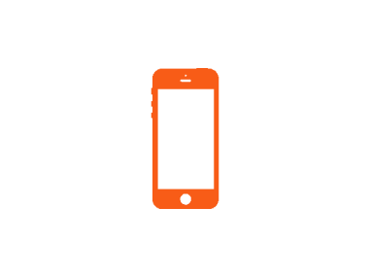


Agenda
Introduction
Literature Review
Motivation
Aims & Objectives
System Architecture
Technology Review
Limitation
Future Work
Development Methodology
Schedule & Milestone

Slide 3
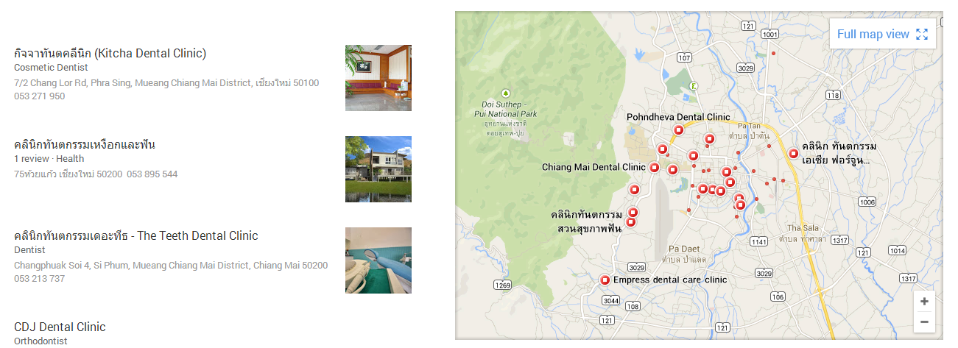
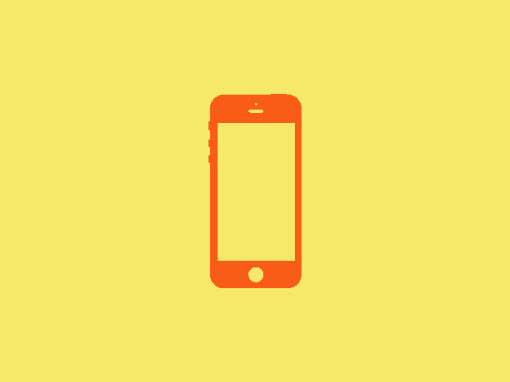
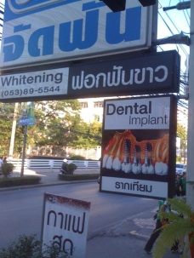
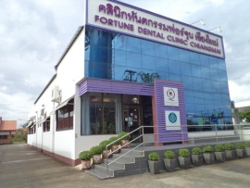
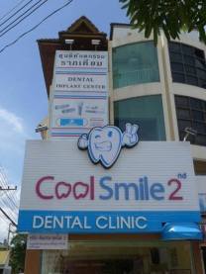
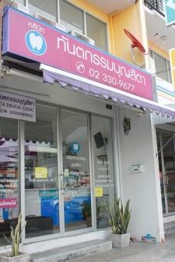

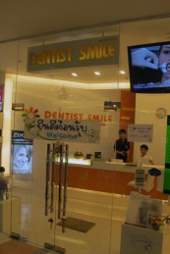

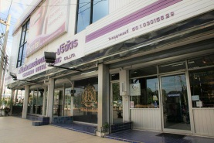
Introduction

Slide 4


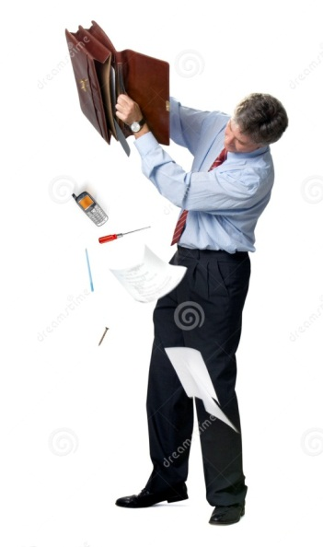

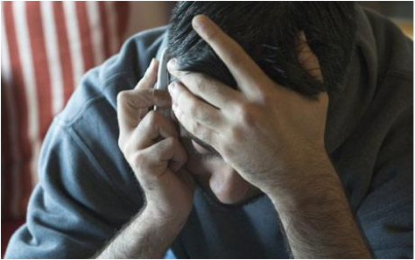
Introduction
Problem
Patient does not has a dental care knowledge
Patient loses their appointment card
Patient forget the appointment date
Patient needs to call to the dental
clinic officer to change
his appointment date

Slide 5

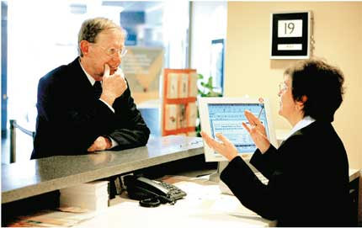
Introduction
Problem
Officer needs to remind, and confirm the appointment by making a call
Officer always has to explain the cost of dental treatment to the patient

Slide 6
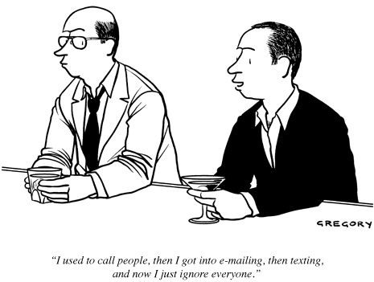

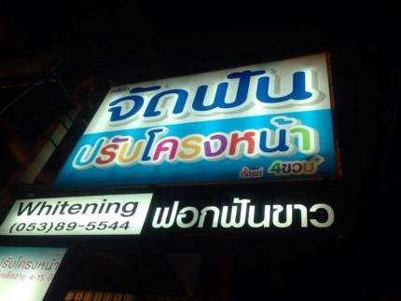
Introduction
Problem
For dentist, it is hard to keep consulting and following up with the patient

Slide 7
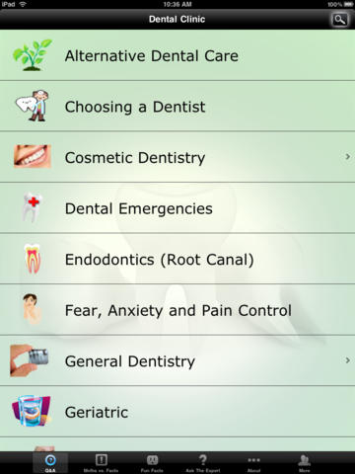
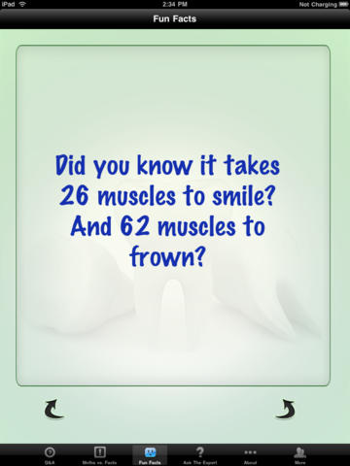
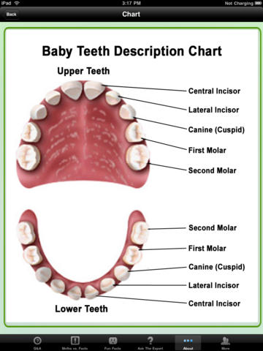
Literature Review
Dental Clinic by Cosmetic Innovations, Inc.
This application provides only the dental care knowledge

Slide 8
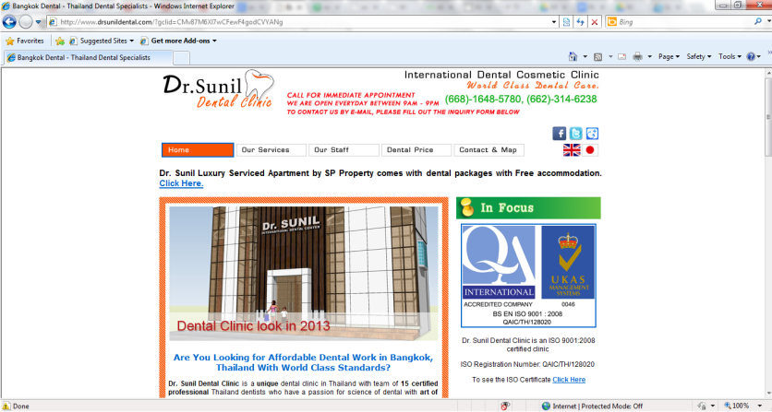
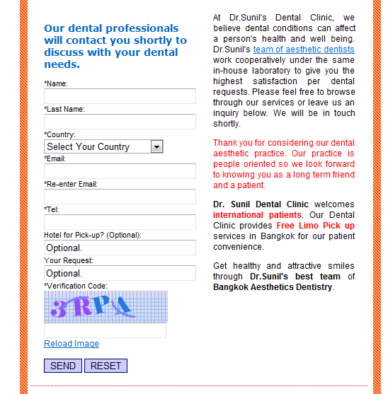
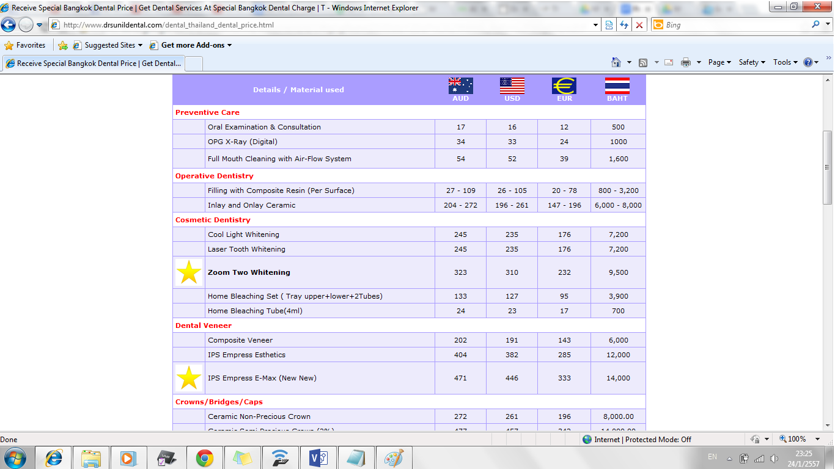
Literature
Dr. Sunil Dental Clinic
This website provide only information, but not cover all services.
Only customer can use the website

Slide 9
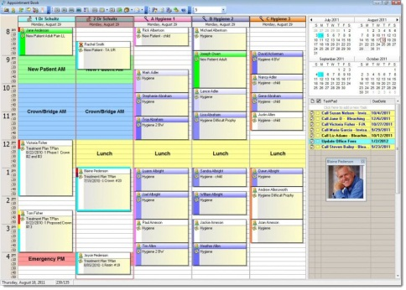
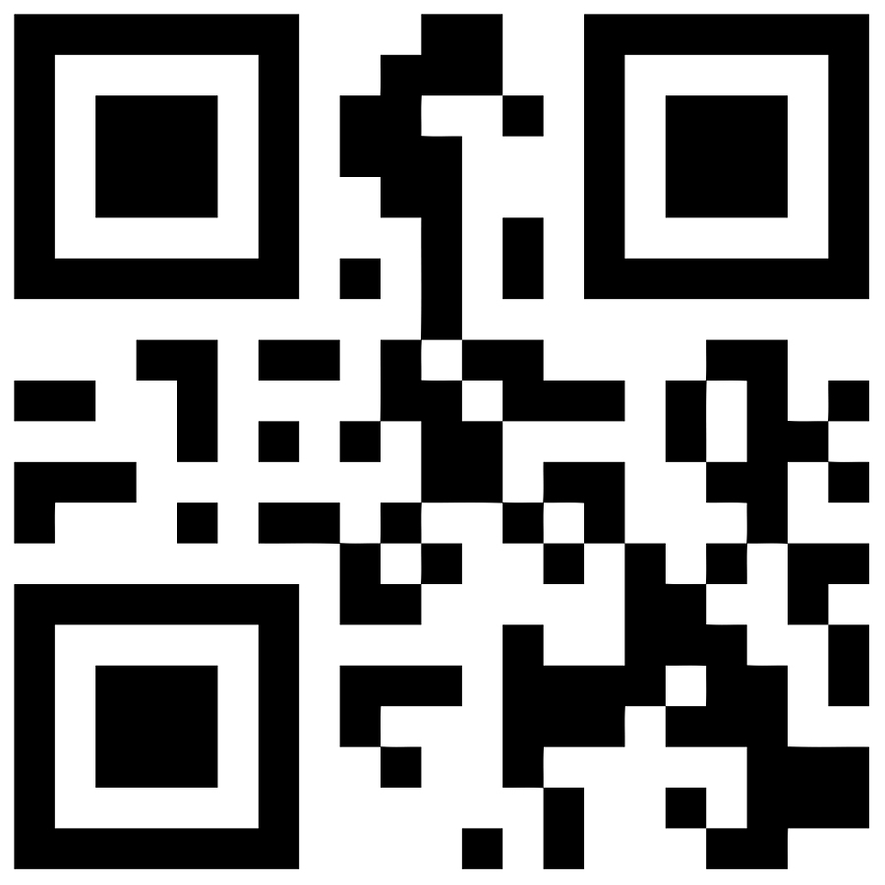




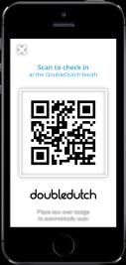
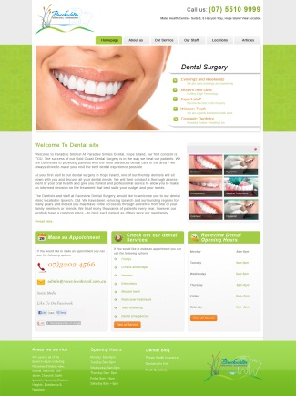

Introduction
Dentist schedule
Reminder
Answer
Officer and Dentist
Cost estimation
Patient
Knowledge,
advertisement, and promotion
Consulting with dentist

Slide 10
Aims
Patient get closer to the dentist and officer
Reserve, or ask for change an appointment date
Reminder from application.
Can ask any question about the dental care information online
Reduce works and time of the officer
Manage appointments and dentists’ schedule
Can identify the patient by using QR code
Dentist interact with the patient directly
Following up his/her patient by using this application
Consulting with his/her patient online
Manage his/her own schedule

Slide 11
Objective
Web application & Mobile application
Appointment management
Schedule sharing
Online consultation
Cost estimation
Advertisement and promotion
Providing knowledge of dental care
Patient identification
Real-time information sharing

Slide 12
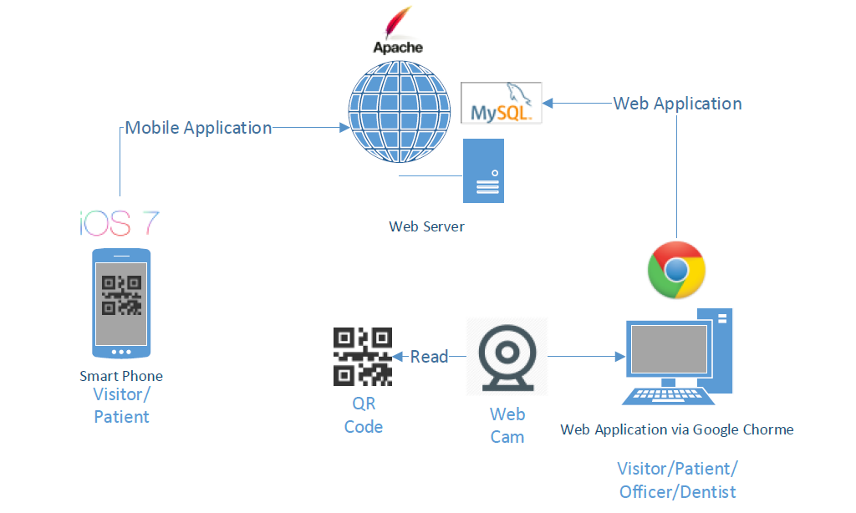
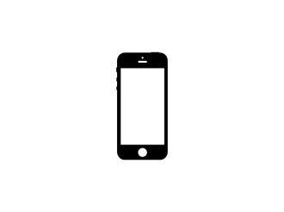


System Architecture

Slide 13



Technology Review
Apache web server
Apache web server a public-domain open source web server
MySQL Server
MySQL Server is an open source database that can be used in many different platforms
HTML5
HTML5 is markup language used for creating websites

Slide 14

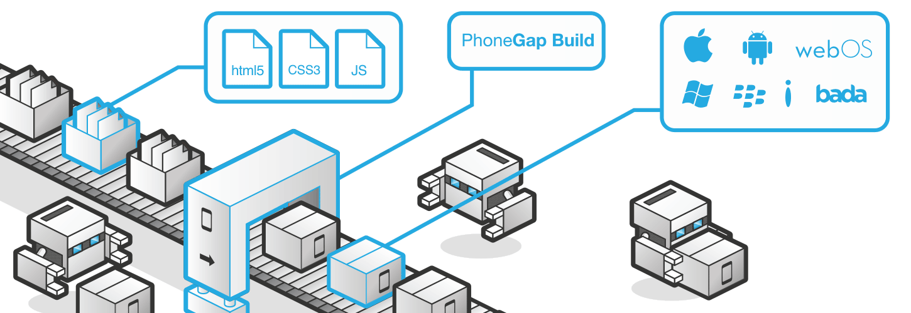
Technology Review
Phonegap is an application framework that enable to develop mobile application by using HTML,HTML5 and javascript

Slide 15
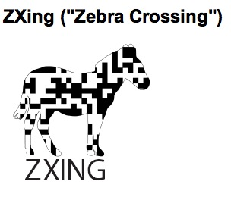
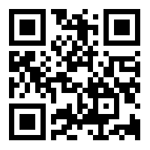
Technology Review
Zxing use for generate the QR code

Slide 16



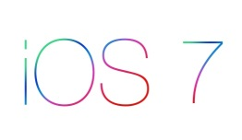
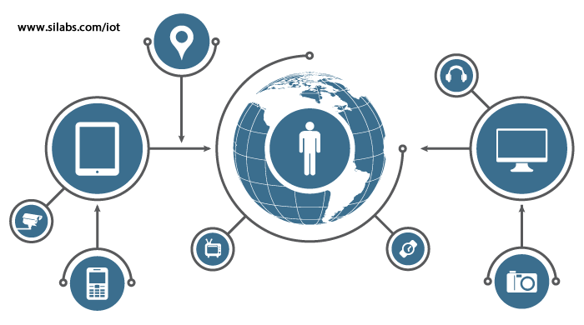
Limitation
Google chrome
This application can use only in the google chrome
Wifi and 3G
Should connect with the internet first
iOS7
Should use the ios7 or newer version

Slide 17
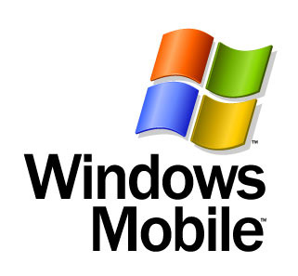
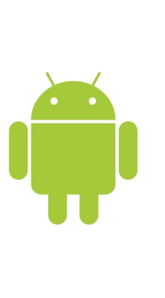



Future work
Support other major operating system platforms, for example; Android and Windows Mobile
Support other web browser, for example internet explorer, Firefox
Use other technologies to provide more convenient services to clinic officers and customers

Slide 18
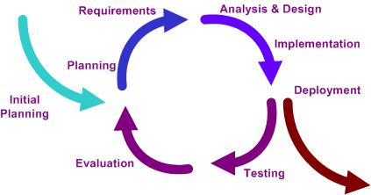
Software Development Process
Iterative software development process
Develop a system through repeated cycles (iterative) and in smaller portions at a time (incremental)

Slide 19
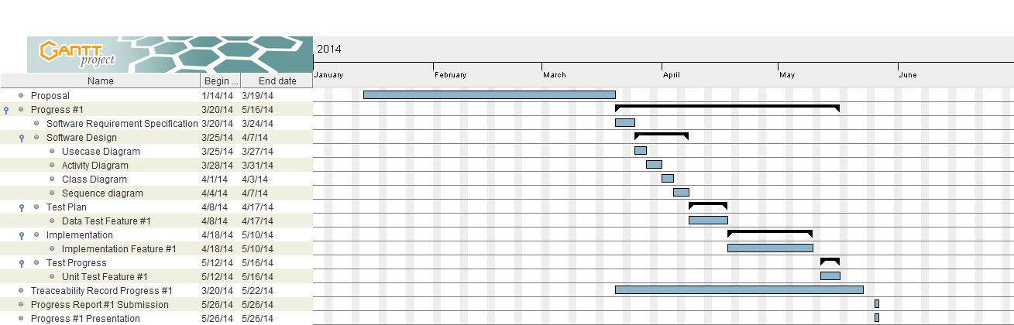
Schedule & Milestone
Progress #1
Feature1: Schedule management

Slide 20
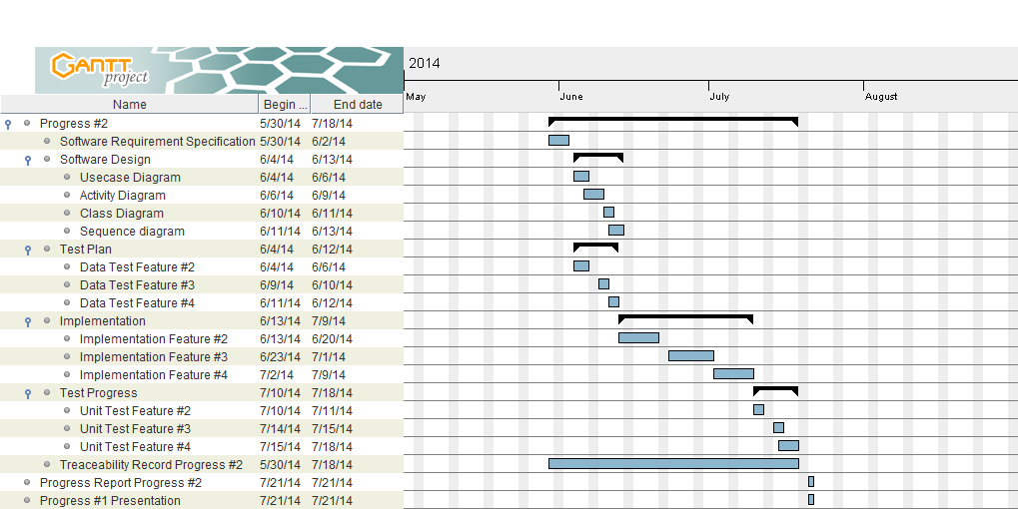
Schedule & Milestone
Progress #2
Feature2: Appointment management
Feature3: A dental clinic information and promotion
Feature4: Cost estimation of dental treatments

Slide 21
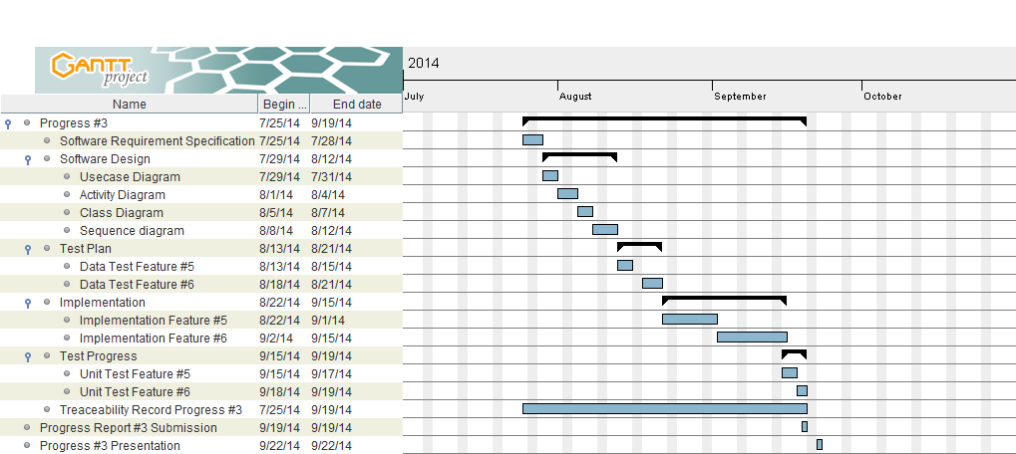
Schedule & Milestone
Progress #3
Feature5: Patient identification using QR code
Feature6: Dental care consulting and following up

Slide 22
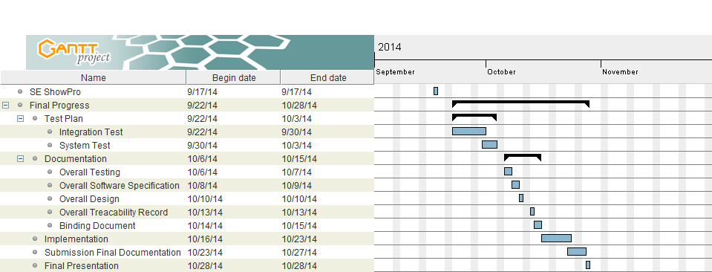
Schedule & Milestone

Slide 23
Q & A

Slide 24
Thank you
For your attention

